Slide 1
Untangling production monitoring
Nik Molnar @nikmd23

Notes:
Logging (contosoretail-it):
1. Show getting started screen & injestion number
2. Show queries
3. Pin last query to "Monitoring & Analytics" dashboard and refresh it
Usage?
Metrics (contosoretailweb):
1. Show live metrics, show main server
2. Increase traffic from CloudShop App
3. See the changes live
4. Switch over to the metrics preview.
5. Add metric for Server Requests, Sum and add City as the next dimension
Tracing (contosoretailweb):
1. Show App Map
2. Click edge with most errors
3. Investigate failures
4. Click 284 409 Response code
5. Click the suggested one
6. Click the error triangle
Infrastructure software is in the midst of a paradigm shift. Containers, orchestrators, microservices architectures, service meshes, immutable infrastructure, and functions-as-a-service (also known as “serverless”) are incredibly promising ideas
that fundamentally change the way software is built and operated. As a result of these advances, the systems being built across the board—at companies large and small—have become more distributed, and in the case of containerization, more
ephemeral.
Most organizations are at the stage of early adoption of cloud
native technologies, with the failure modes of these new paradigms still remaining somewhat nebulous and not widely advertised. To successfully maneuver this brave new world, gaining visibility into the behavior of applications becomes
more pressing than ever before for software development teams.
Services are getting simpler, systems are getting more complex.

Slide 2
Pre Production
Production
- Unit tests
- Regression tests
- Code coverage
- Static analysis
- Integration tests
- Load tests
- Feature flagging
- Traffic shaping
- Monitoring
- Logging
- A/B Testing
- Monitoring
- Logging
- A/B Testing
Deploy
Release
POST Release
Quality Assurance

Slide 3

Observability
Monitoring
Testing
Testing can be used very effectively to show the presence of bugs but never to show their absence
Dijkstra
Notes:
The monitoring/Observability of a system evolves with the system, just like a test suite evolves with a system.
Your monitoring system should address two questions: what’s broken, and why? The “what’s broken” indicates the symptom; the “why” indicates a (possibly intermediate) cause.“What” versus “why” is one of the most important distinctions in writing good monitoring with maximum signal and minimum noise.
Building “monitorable” systems requires being able to understand the failure domain of the critical components of the system proactively. And that’s a tall order. Especially for complex systems. More so for simple systems that interact complexly with one another.
The more mature a system, the better understood are its failure modes. Battle hardened, “boring” technology often comes with well-publicized, well-understood and monitorable failure modes. Being able to entirely architect away a failure mode is the best thing one can do while building systems. The next best thing one can do is to be able to “monitor” impending failures and alert accordingly.
I’m beginning to think one of the design goals while building systems should be to make it as monitorable as possible — which means minimizing the number of unknown-unknowns.
Monitoring provides a good approximation of the health of a system, but monitoring doesn’t prevent failure entirely.
Monitoring, as such, is best limited to key business and systems metrics derived from time-series based instrumentation, known failure modes as well as blackbox tests. “Observability”, on the other hand, aims to provide highly granular insights into the behavior of systems along with rich context, perfect for debugging purposes. Since it’s still not possible to predict every single failure mode a system could potentially run into or predict every possible way in which a system could misbehave, it becomes important that we build systems that can be debugged armed with evidence and not conjecture.
In its most complete sense, observability is a property of a system that has been designed, built, tested, deployed, operated, monitored, maintained, and evolved
in acknowledgment of the following facts:
- No complex system is ever fully healthy.
- Distributed systems are pathologically unpredictable.
- It’s impossible to predict the myriad states of partial failure various parts of
the system might end up in.
- Failure needs to be embraced at every phase, from system design to imple
mentation,
testing, deployment, and, finally, operation.
- Ease of debugging is a cornerstone for the maintenance and evolution of
robust systems.

Slide 4
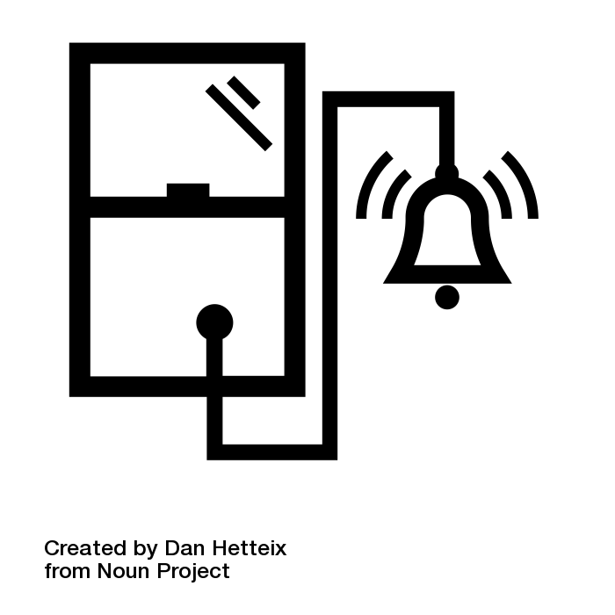

Monitoring
Observability
- Alerting
- Overview
- Debugging
- Profiling
- Dependency analysis
Proactive
Reactive
Ops
Dev
Monitoring vs. Observability
Notes:
Security camera is Observability - so you can ask a question later that you don’t have today.
Door and window sensors are monitoring, looking for a known failure mode and issuing an alert.
Monitoring aligns with being on call, Observability requires a developer, and tooling to make sense of the data collected
Having data at our disposal alone doesn’t solve problems. Problem solving also involves the right amount of engineering intuition and domain experience to ask the right questions
Furthermore, unlike “monitoring” which is known failure centric, “Observability” doesn’t necessarily have to be closely tied to an outage or a user complaint. It can be used as a way to better understand system performance and behavior, even during the what can be perceived as “normal” operation of a system.

Slide 5
Dig
Logs
Metrics
Http
Black
White
Getting State
Ping
Traces
Ssh

Slide 6
#1. Logging
/law-ging/ The collection of discrete events, which may be read by humans, machines, or both.

Slide 7
#2. Metrics
/met-riks/ The measuring and aggregation of events over time which may drive counters, gauges, histograms or other data visualization mechanisms.
Notes:
Metrics are a numeric representation of our data and as such can fully harness the power of mathematical modeling and prediction to derive knowledge of the behavior of our system over intervals of time in the present and future

Slide 8
#3. Tracing
/trey-sing/ The collection of discrete events, with causal ordering, across process boundaries, that is scoped to a transaction.
Notes:
I see both traces and metrics as an abstraction built on top of logs [events?] that pre-process and encode information along two orthogonal axes, one being request centric, the other being system centric.

Slide 9
Tracing
Observability Three ways
Metrics
Logging

Slide 10

Tracing
Observability Three ways
Metrics
/catalog/item/123
ID : 7C9A
90th
/catalog/item/*
Logging
Item Details Performance Graph
Item Details Request Trace
7C9A, 343.78, Item (123) not found in cache, INFO
3B1Y, Disk utilization high, WARN
2F4G, NullReferenceException: Foo, ERROR
7C9A, 845.92, Item (889) found in DB, INFO
8V8E, review {user:554678 item:123, stars:4}, INFO
4Y7S, User (554678) logged out, DEBUG
Item Details Logs

Slide 11
Demonstration
Application Insights

Slide 12
R e d
U S E
Rate
Utilization
Errors
Saturation
Durration
Errors
Notes:
- The rules that catch real incidents most often should be as simple, predictable, and reliable as possible.
- Data collection, aggregation, and alerting configuration that is rarely exercised (e.g., less than once a quarter for some SRE teams) should be up for removal.
- Signals that are collected, but not exposed in any prebaked dashboard nor used by any alert, are candidates for removal.
- The corollary of the aforementioned points is that monitoring data needs to actionable
“Read your writes” - also important for metered systems

Slide 13
.NET
Get Started
> install-package microsoft.applicationinsights
> npm install applicationinsights
Node.js

Slide 14
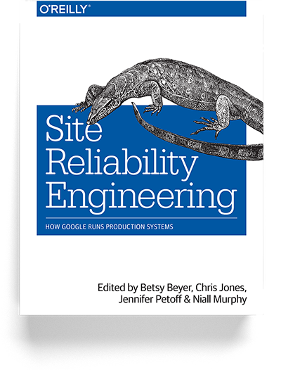
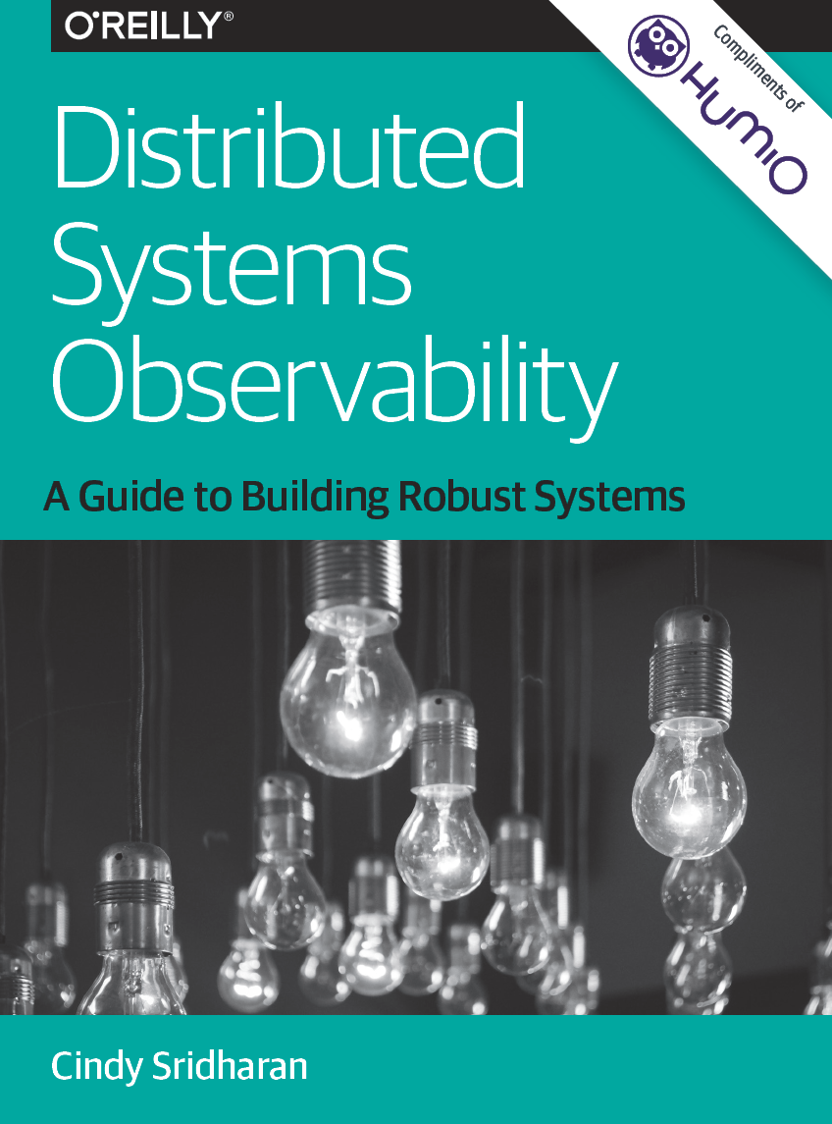
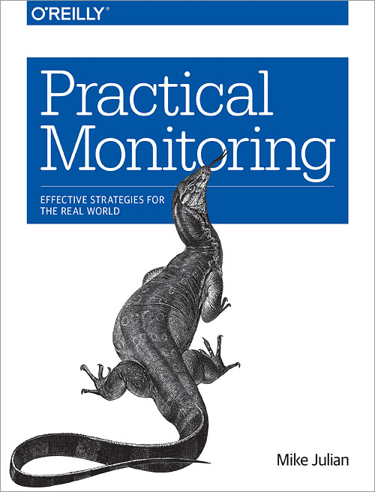
Resources

Slide 15

Thank You!
http://nikcodes.com/monitoring
Nik Molnar @nikmd23


